Slide 1
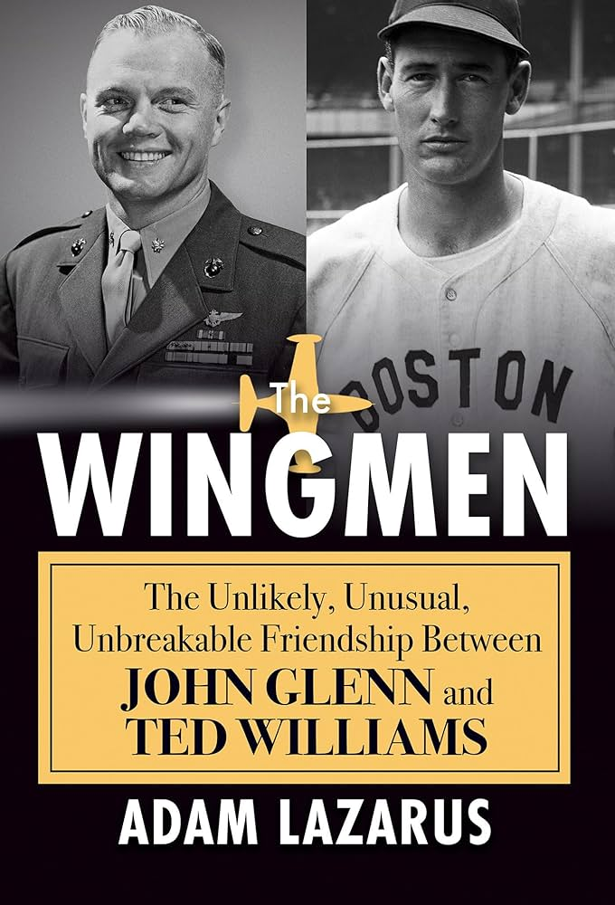
Book review by Jim Holleran
Adam Lazarus recaptures the unlikely 50-year friendship between an American odd couple. Boston Red Sox star Ted Williams was perhaps the greatest hitter in baseball history while Marine pilot John Glenn became the first astronaut to orbit the Earth. Williams became Glenn’s wingman for 8 combat missions during the Korean War.

Slide 2
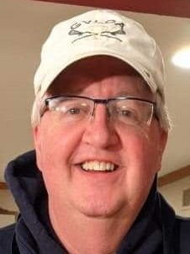
About the reviewer
Jim Holleran of Penfield writes a weekly general interest column for the Journal in Ogdensburg, NY.
He worked as a copy editor and sports editor for the Democrat and Chronicle from 1984-2009, then taught at RCSD for 19 years.
He is an avid baseball fan, particularly of the Cleveland Guardians. He was coached in high school by his father, also a wartime baseball player.
He referees high school basketball and lacrosse.

Slide 3
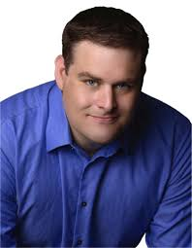
About the author
Adam Lazarus released this fifth book in August 2023. He lives in Atlanta with his wife, Sarah, and sons Aaron and Benjamin.
He earned a Bachelor’s degree from Kenyon College (Ohio) in 2004 and a Master’s degree in professional writing from Carnegie Mellon in 2006.
He has freelanced for USA Today and Atlanta Journal-Constitution and worked for several sports websites.

Slide 4
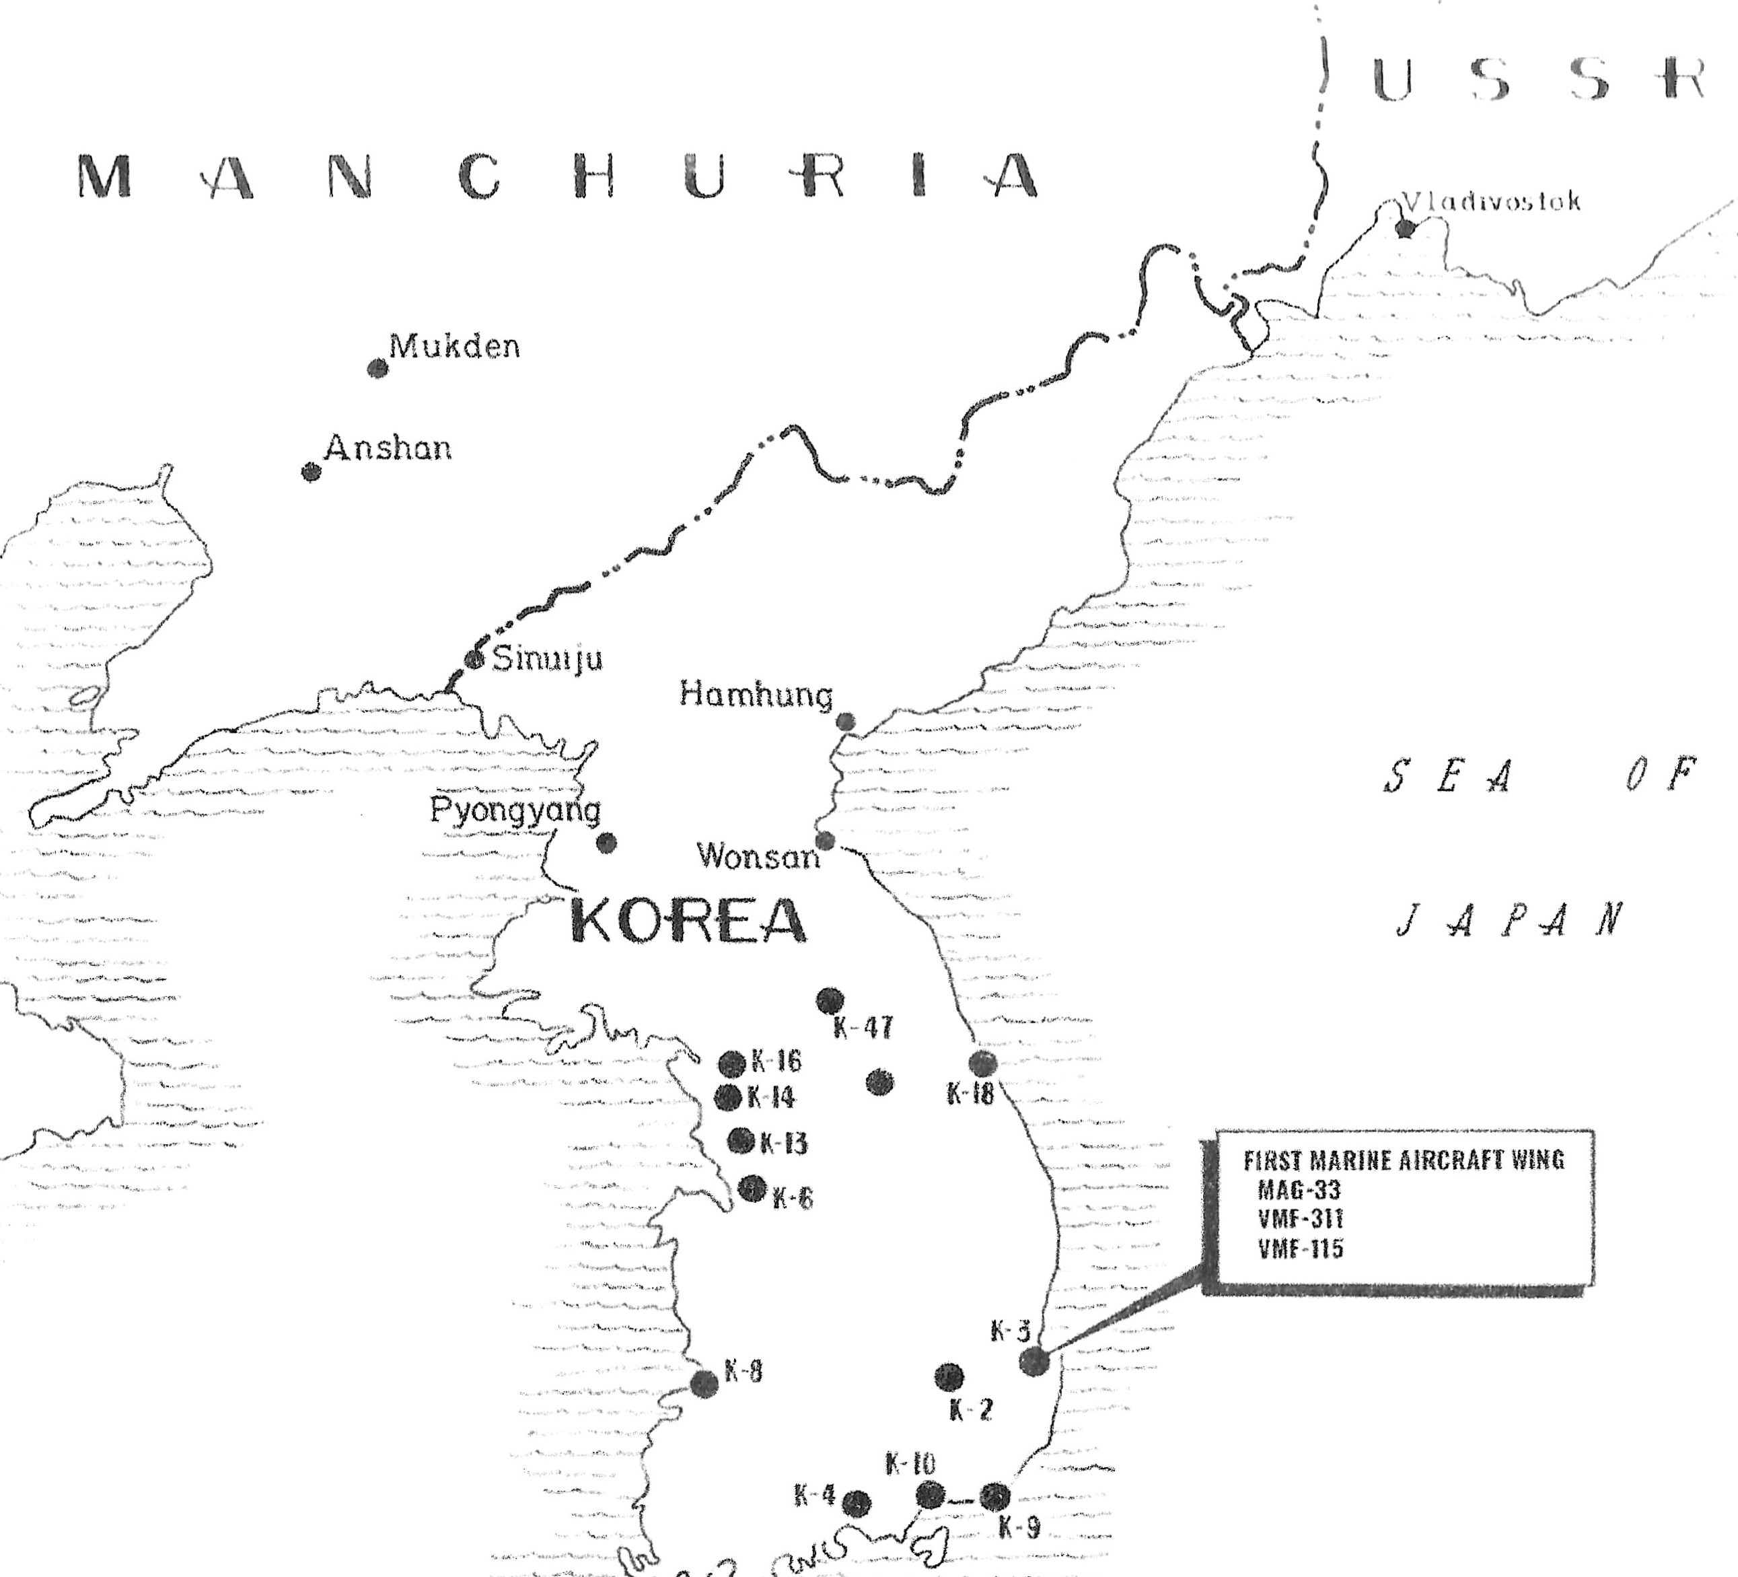
Synopsis:
Visualizing
the content
Adam Lazarus references several airbases (designated by K). This map will enhance your reading. Red bar shows DMZ at 38th Parallel.

Slide 5
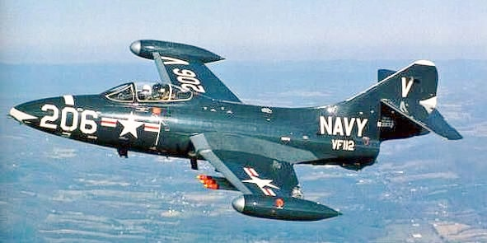
Synopsis:
Sorting out acronyms
Decoding acronyms to describe combat planes: V – Fixed-wing aircraft Z – Lighter-than-air H – rotorcraft (helicopter)
All are followed by a squadron number.
Kinds of aircraft: P-38: fighter plane C-47: passenger (Gooney Bird) PBY: cargo F9F, F4U: jet fighters
VMAT-20, VMF-223: training groups VMO, VMF: fighter squadrons

Slide 6
Synopsis:
The Odd Couple
John Glenn
Graduate of Muskingum College in his hometown of New Concord, OH
Married to his HS sweetheart for 73 years; 2 children
Democratic senator from Ohio
Ran for Democratic nomination for president in 1984; lost to Walter Mondale.
Ted Williams
San Diego native married 3 times; 1 partner; several liaisons
Three children
Described by one biographer as “to the right of Atilla the Hun.’’
Supported Barry Goldwater, Richard Nixon and any Republican candidate.

Slide 7
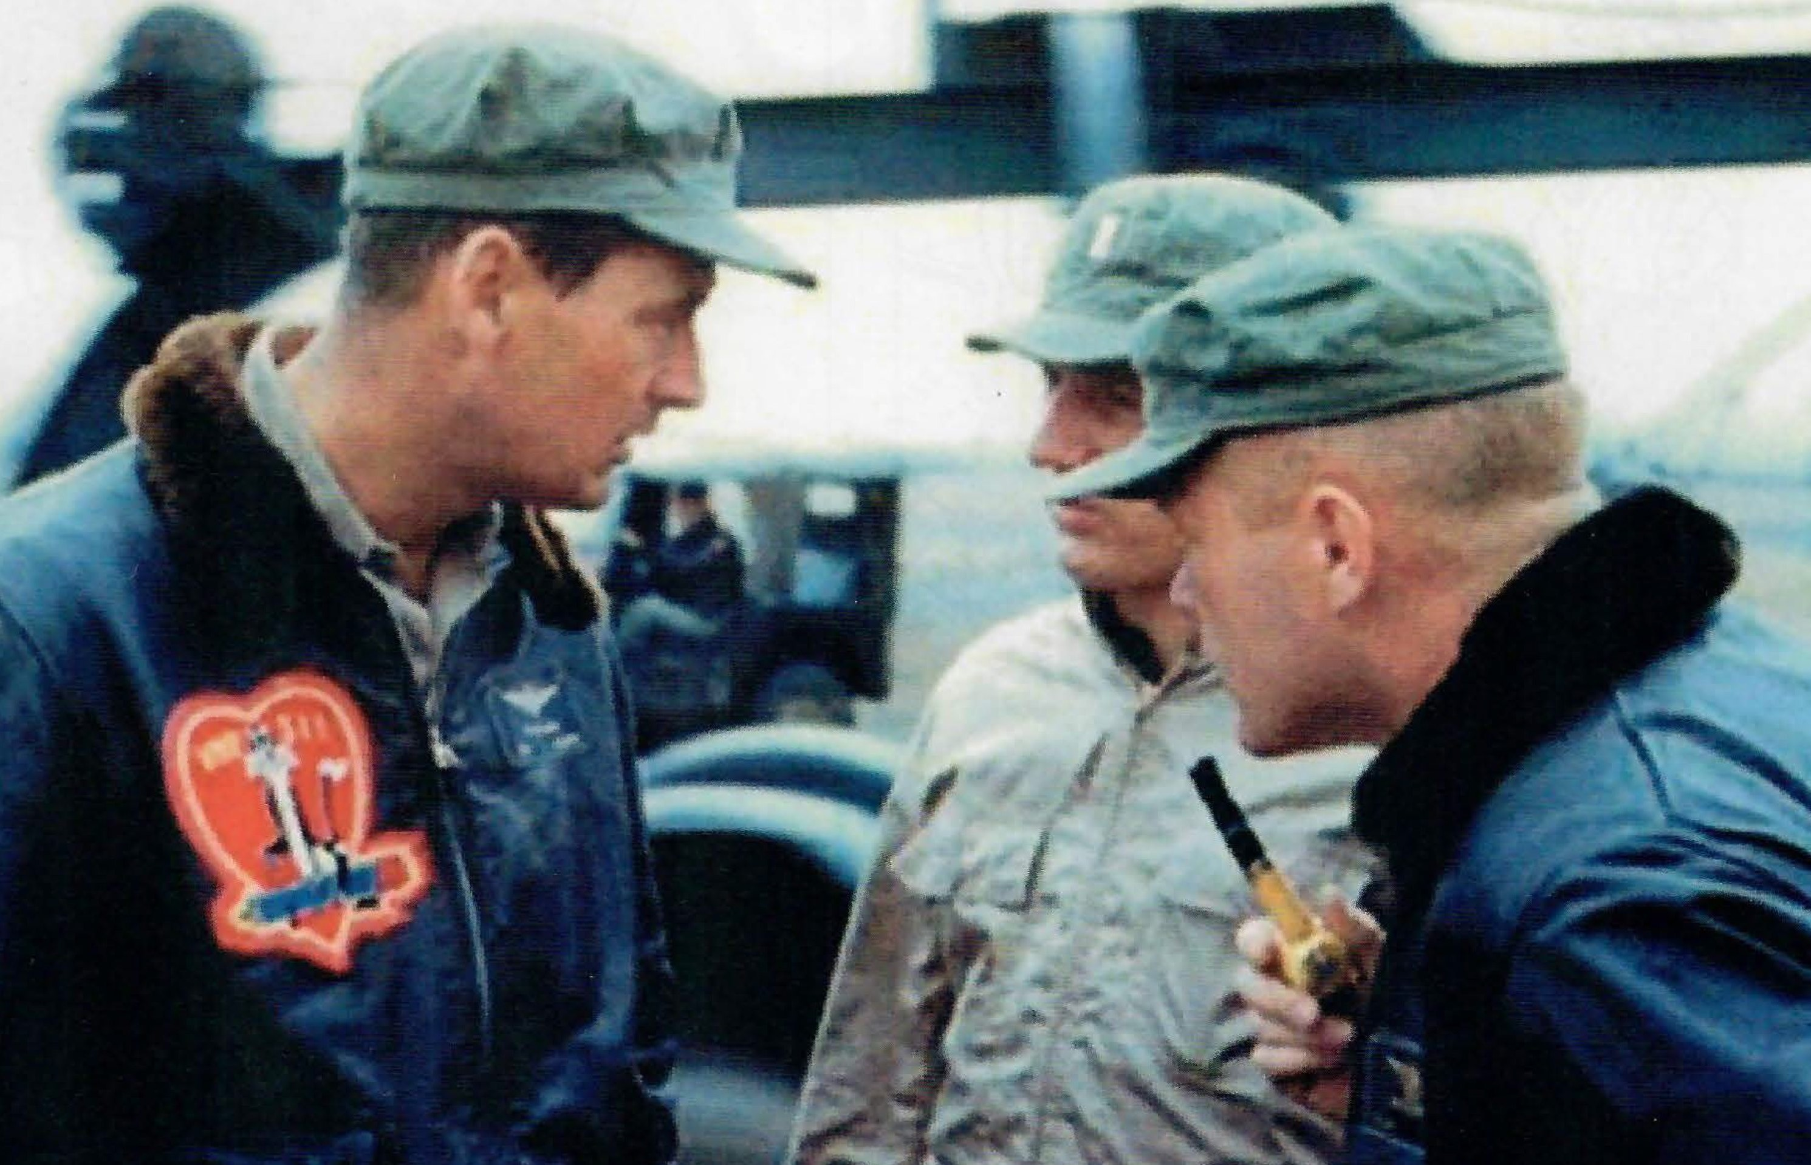
Synopsis:
Getting to Korea
Ted Williams in WW II
During the ‘42 season, Williams enlisted in a Navy pilot training program.
Instructed pilots; was awaiting orders in Hawaii on V-J Day
Never resigned; remained in Marine Corps Reserve; promoted to Captain; recalled in 1952
Williams left, and Glenn, right, huddle with a commander in Korea.

Slide 8
Synopsis:
Getting to Korea
John Glenn in WW II
Earned a pilot’s license during college
Quit Muskingum; joined Army Air Corps. Transferred to Marines.
Finished war flying 57 combat missions from Midway Atoll and Marshall Islands
Williams left, and Glenn, right, huddle with a commander in Korea.

Slide 9
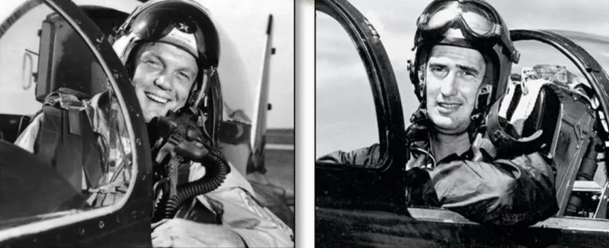
Synopsis:
Becoming wingmen
Welcome to the jet age.
April 30, 1952: “Ted Williams Day.’’ Waves his cap to the crowd, hits a game-winning homer. Leaves for military.
Glenn was ‘’sniveling’’ for combat duty. Left a training school in Quantico, Va.
Arrived 12 days apart in Korea. Glenn said he was “OK.’’
Became part of the “Blow and Go’’ group.
Flew 8 missions together over North Korea.

Slide 10
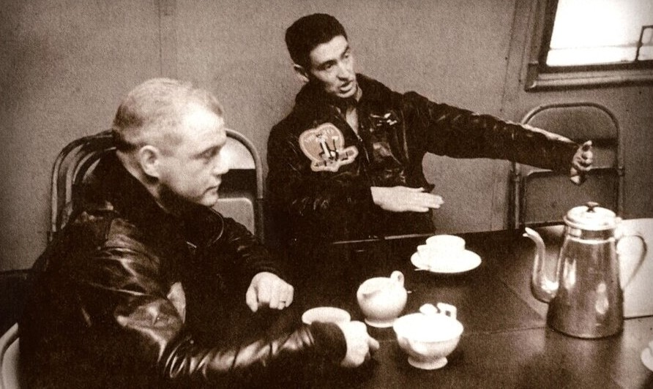
Synopsis: Essence of a wingman
“Fighter formation flying takes its basis in the rule that the wingman under all circumstances sticks with it section leader …. The wingman’s first and primary duty ahead of everything else is to stick with his section leader.’’
First Lieutenant J.H. Glenn, Jr.
Squadron 218 Doctrine, 1948

Slide 11
Synopsis:
The trouble with Glenn
Wingmen watch skies for dangerous MiGs.
Wingmen lead you out of danger, provide advice, tell you when to eject.
Pilots didn’t like flying with Glenn. “Blow and Go’’ did not mean circling back to fire cannons. (p.59)
Glenn was hit so many times he became “Magnet Ass.’’
Mocking his baseball prowess, Williams was called “Bush League.’’

Slide 12
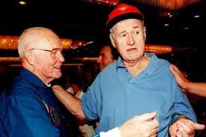
Synopsis:
Flying independently
Williams returns to BoSox; enters Hall of Fame 1966
Manages Washington Senators; professional fishing tours; endorses Sears & Roebuck gear.
Glenn joins NASA; first American to orbit Earth in 1962.
Recruited by Kennedys into Democratic politics
Wingmen reunite at 1998 NASA event.

Slide 13
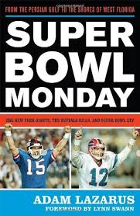
More works by Lazarus:
Super Bowl Monday
Lazarus retells the Buffalo Bills first trip to the Super Bowl, better known here as “Wide Right,’’ a 20-19 loss to the New York Giants on Jan. 27, 1991.
The Bills lost the first of four consecutive Super Bowls when Scott Norwood’s 47-yard field goal-attempt sailed outside the goalpost with 4 seconds left.

Slide 14
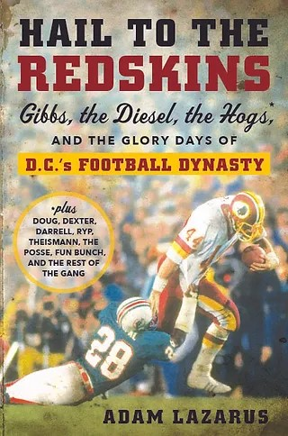
More works by Lazarus:
Hail to the Redskins
Lazarus explains how the Washington Redskins (now Commanders) captured the fancy of the capital from 1981-92 under Hall of Fame Coach Joe Gibbs.
The Bills did their part too, losing 37-24 in the 1992 Super Bowl in Minneapolis, MN.
The book title is borrowed from the team’s fight song.

Slide 15
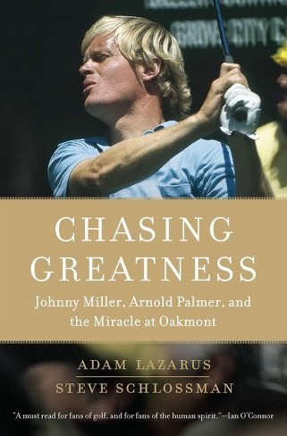
More works by Lazarus:
Chasing Greatness
Lazarus recounts Johnny Miller’s stunning victory at the 1973 U.S. Open at Oakmont CC in suburban Pittsburgh.
In difficult Sunday conditions, he shot a record 63 to defeat the likes of Arnold Palmer, Jack Nicklaus, Tom Weiskopf and Lee Trevino.

Slide 16
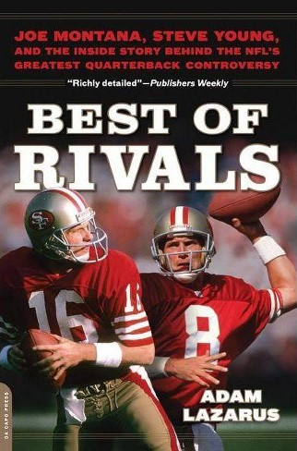
More works by Lazarus:
Best of Rivals
Lazarus recounts the rivalry between incumbent QB Joe Montana and backup Steve Young in the early 1990s with the San Francisco 49ers.
Montana wins 4 Super Bowls before an elbow injury. Steve Young takes over, wins SB, and Montana is traded to Kansas City.
Both enshrined in the Hall of Fame.

Slide 17
More works by the reviewer
Jim Holleran’s weekly newspaper column
https://hollerangetsitwrite.com/
Look under “Reflections of a River Rat’’
Find a brief biography and editing and writing services.
PIE Network
Customized Irish songs.
Copy of this slide show? Provide an email.

